Slide 1
Enhancing eTang System
Adi Balaji Ayanam

Slide 2
Overview of eTang Portal Problem
Purpose
Challenges
Goal
01
02
03
Facilitates scheduling of health service appointments at UC Berkeley.
Long wait times
Limited availability
Disruptions from no-shows and late arrivals.
Develop a more efficient system to enhance satisfaction, reduce wait times, and decrease no-shows.

Slide 3
The eTang Portal
Login and Interface: Students log in via university accounts to access the eTang portal.
A
B
Appointment Selection: Choices include primary care or mental health, with selection of available doctors and times.
C
Booking Process: Students select their preferred time slot to confirm appointment.

Slide 4
Portal Inefficiencies
No Shows/Late Arrivals
Frequent missed appointments lead to resource wastage and schedule disruptions.
Variable Demand & Supply
Inefficiencies arise from overbooking during peak times and underutilization off-peak.

Slide 5
Proposed Model Features & Approach
Enhances resource utilization, allowing more effective service to students.
Improves health outcomes through more reliable and timely access.
Significance
A
Priority-Based Scheduling: Uses historical data to prioritize reliable students.
Real-Time Adjustments: Dynamically optimizes schedules to minimize disruptions.
B
Proposed Features
Approach & Sensitivity Analysis
C
Analyzes current inefficiencies.
Conducts sensitivity analysis to ensure model robustness under various conditions.

Slide 6
Stakeholders
Students
Long waits during busy times deter appointment bookings. Growing frustration reduces trust and satisfaction with the healthcare system.
Healthcare Providers
eTang
Unpredictable no-shows and late arrivals create stressful, inefficient schedules. Inefficiencies hinder providers from seeing more students.
Improved scheduling could enhance both user experience and health outcomes by ensuring more reliable and timely medical consultations!

Slide 7
Assumptions and Rationales
Patient Behavior Variability
Patients show varied attendance reliability.
Rationale: Helps in planning and mitigating no-show impacts.
Doctor Availability & Flexibility
Doctors manage a fixed number of appointments daily across various types.
Rationale: Ensures quality care and efficient resource use.
Technological Integration
Existing technology supports an advanced, dynamic scheduling system.
Rationale: Key for implementing complex algorithms and real-time updates.

Slide 8
Assumptions and Rationales
Real-Time Data Accuracy
Data is accurate and updated in real-time.
Rationale: Critical for making informed system decisions.
Patient & Provider Compliance
Patients and providers adhere to new system protocols.
Rationale: Essential for effective system operation and smooth transition

Slide 9
Our Model
Gather comprehensive data on patient appointments, including duration, punctuality, no-shows, and cancellations.
Apply statistical models to predict outcomes like likely no-shows or appointment durations.
(logistic regression, linear regression )
Data Collection
Feature Engineering
Predictive Modeling
Identify key factors affecting appointment efficiency such as time of day, patient demographics, and historical attendance patterns.

Slide 10
Model Optimization
Algorithm Optimization
Real-Time Adjustments
Evaluation
Utilize optimization techniques such as linear programming to allocate time slots effectively. Aim to maximize resource utilization (e.g., doctor time) and minimize patient waiting times.
Integrate a system that adapts to real-time changes, such as cancellations or emergency walk-ins, to re-optimize the schedule dynamically.
Regularly evaluate the scheduling system using metrics like patient satisfaction and throughput, and adjust model parameters based on feedback to continuously enhance performance.

Slide 11
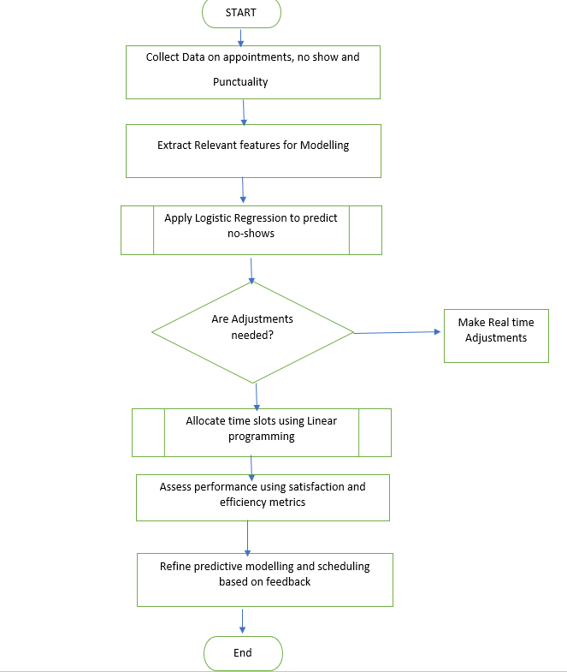

Slide 12
Example Input
Data collection
100 appointments
30% no-show rate
Average appointment duration: 20 minutes
Punctuality varies (some are on time, others late by 5-20 mins)
Logistic Regression for No-Show Prediction
Input Variables: Past no-show history, appointment time, day of the week.
Outcome: Likelihood of a no-show
(binary output: 0 = will attend, 1 = no-show).

Slide 13
Example Optimization
Linear Programming
Min total unutilized doctor time + total patient wait time
Subject to:
- Appointment constraints (e.g., doctors' availability, room availability)
- No more than one patient per time slot unless anticipated no-show
Objective
Decision Variables
Constraints
Minimize total empty doctor time and patient waiting time.
Assignment of time slots to patients (binary: 1 if assigned, 0 otherwise).
Each patient gets exactly one slot. Slots must account for expected durations and potential delays.

Slide 14
Analysis and Discussion
Key Outcomes
Challenges
Improved Efficiency: Reduced wait times through optimized scheduling.
Lower No-Shows: Decreased missed appointments with reliability scoring.
Adaptability: Keeping the system accurate with real-time data is challenging.
User Compliance: Ensuring everyone follows new protocols.
Next Steps
Impacts
Further Analytics: Use machine learning to improve predictive accuracy.
Regular Evaluation: Continuously update and assess the system for better performance.
Patient Satisfaction: Improved due to reliable scheduling and shorter waits.
Resource Use: Enhanced efficiency in healthcare resource utilization.

Slide 15
References
Marbouh, Dounia et al. “Evaluating the Impact of Patient No-Shows on Service Quality.” Risk management and healthcare policy vol. 13 509-517. 4 Jun. 2020, doi:10.2147/RMHP.S232114
Klitzman, Robert. “"Patient-time", "doctor-time", and "institution-time": perceptions and definitions of time among doctors who become patients.” Patient education and counseling vol. 66,2 (2007): 147-55. doi:10.1016/j.pec.2006.10.005
Zach Bobbit. “How to Interpret Logistic Regression Intercept (with Example).” Statology, 17 Apr. 2023, www.statology.org/interpret-logistic-regression-intercept/.
Niu, Tiantian, et al. “A Review of Optimization Studies for System Appointment Scheduling.” MDPI, Multidisciplinary Digital Publishing Institute, 25 Dec. 2023, www.mdpi.com/2075-1680/13/1/16.
Han Shuihua a, et al. “Appointment Scheduling and Routing Optimization of Attended Home Delivery System with Random Customer Behavior.” European Journal of Operational Research, North-Holland, 31 Mar. 2017, www.sciencedirect.com/science/article/abs/pii/S0377221717302916.
Sharan Srinivas a b c, et al. “Consultation Length and No-Show Prediction for Improving Appointment Scheduling Efficiency at a Cardiology Clinic: A Data Analytics Approach.” International Journal of Medical Informatics, Elsevier, 1 Oct. 2020, www.sciencedirect.com/science/article/pii/S1386505620309059.

